Slide 1

Code Quality
Coping up with new coding standards

Slide 2

Basic Questions
What is
Why should I care about
What if I don’t care about
How to write

Slide 3


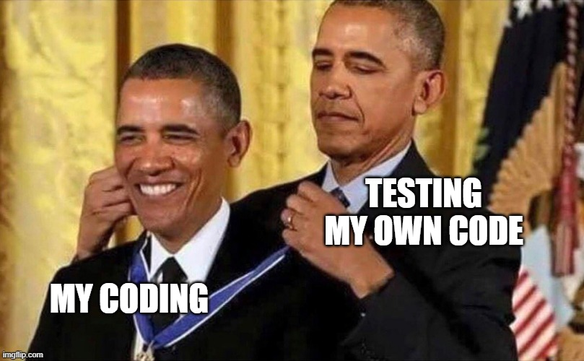



Misconception of every developer

Slide 4
Good Quality Code
In an ideal world, a best code is –
Does what it is supposed to do(and does not do what is not intended)
Has a consistent style, which we call a global or organization level standard
Really easy to understand
Well documented
Well tested
And may not exist!

Slide 5
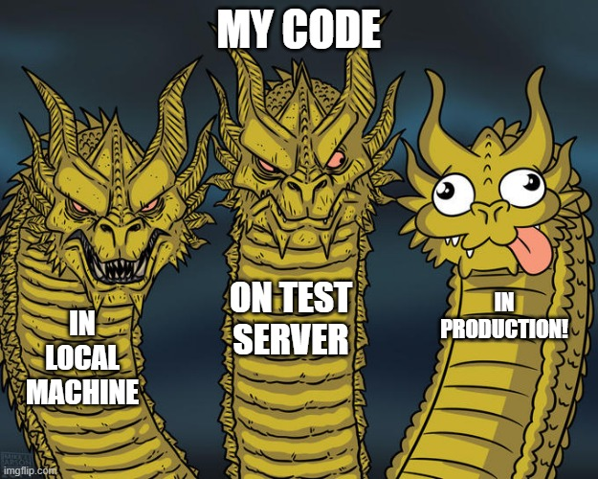
The problem gets real in PROD

Slide 6
Why does that happen?
There is only one true answer in various forms or having multiple factors leading to the same root cause
Code was not tested
Code has unnecessary branches and conditions
Code is too complex
We ignored/forgot to document the code
Consistency does not matter
What’s a framework? I will do it myself!
BAD
CODE

Slide 7
What if I continue to code in the same way?
Well, its not a choice. It is same as unmonitored and uncontrolled use of a credit card, but in the end, we must pay!.
So, if you
Keep ignoring the code quality issues
Do not write correct test cases
Do not write optimized code
Do not use the features that framework provides
And may more
You are creating a DEBT that can cost big time to your client and organization.

Slide 8
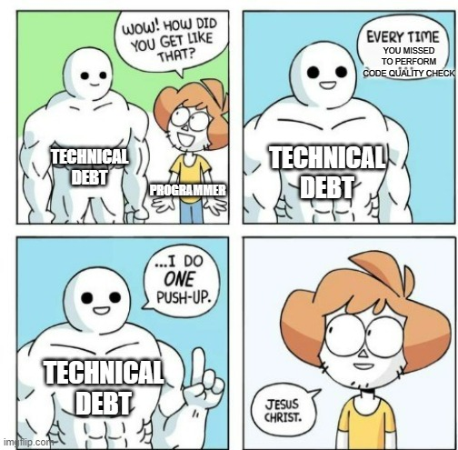
It is called “Technical Debt”

Slide 9
How does it affect the software?
Maintainability is lost
Reliability is lost
Compromises with integrity and security
It can get hard to use
Well, you get the idea.
SO, bad code produces a bad software!

Slide 10
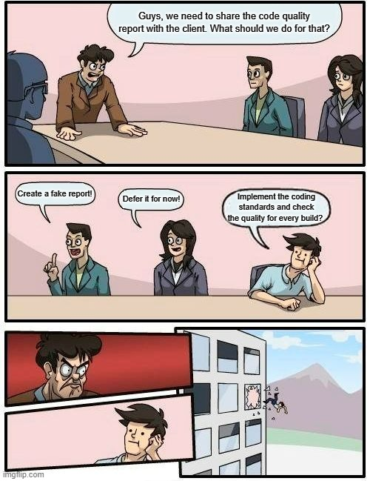
How to achieve code quality?

Slide 11





Use of automation
Its not possible to review all the code manually
So, integrate third party tools and delegate these tasks to such tools
Organizations can set their expectations for coding standards as rules, or we can follow global coding standards
Write Junit test cases for every functionality, feature, issue or change request you get. We can get these cases reviewed, that is simpler!
And before you commit anything, just run all these tools locally so we adhere to the compliance.

Slide 12
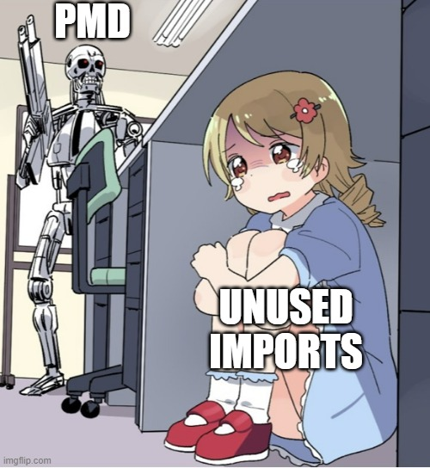
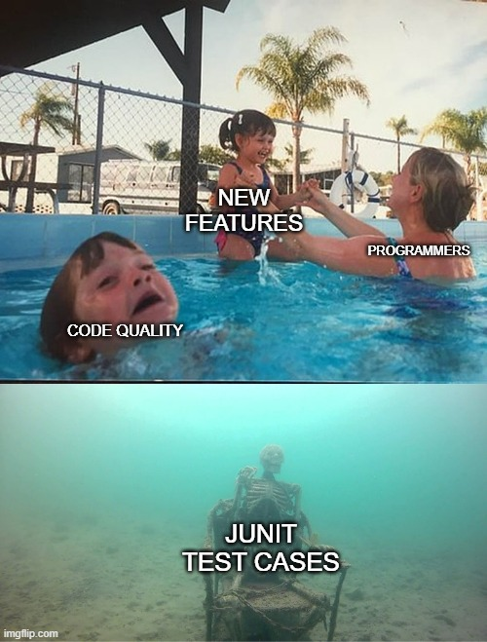

Slide 13
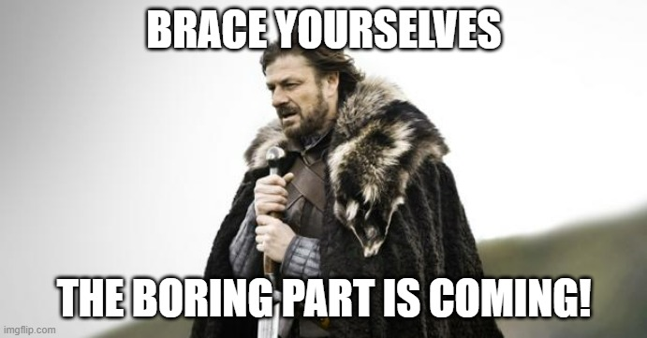
How to utilize the language/framework optimally that we are using

Slide 14
Some pointers
Use lambda, method reference, streams, etc. from Java 8
Use RuntimeException over Checked Exceptions
Remember, Service = Business logic
Use Lombok library

Slide 15
Some pointers
Keep an eye on new features in the framework
Do not over abstract
Do not repeat things, learn to reuse
Keep it simple

Slide 16
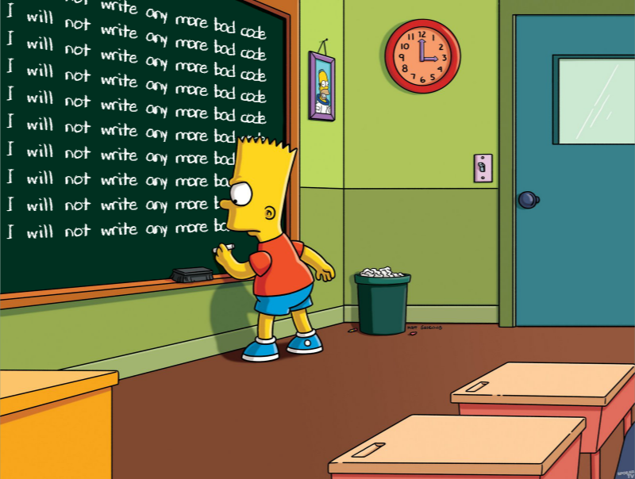
Let's decide that… OR

Slide 17
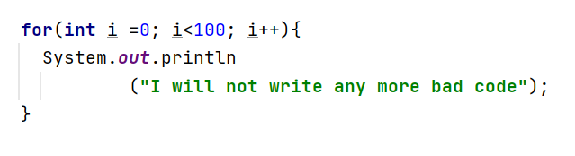
OR

Slide 18
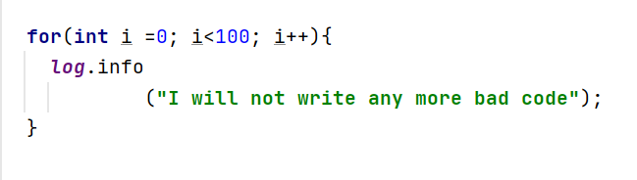
☺

Slide 19
Thank You!

